Slide 1

NEXT-GEN FOOTBALL ANALYTICS
Premier League Global Analytics Platform
Project Vision: Bridging Global Fans with National Heroes

Slide 2
01. Platform Mission & Value Proposition

Slide 3






CORE PROJECT OBJECTIVES
Global Archiving
Live Data Fidelity
Fan Synergy
Tracking the legacy of 100+ nationalities that have graced the English top flight since 1992.
Integration with API-Football for real-time match stats, goals, and assist updates.
Providing a dedicated space for national fanbases to track their specific local stars.

Slide 4
INFORMATION ARCHITECTURE
Navigation Menu | Core Functionality | User Value
Players by Nation | Continental & Flag-based Filtering | Easy discovery of local heroes
Dynamic Rankings | Live Leaderboards (Goals/Assists/Clean Sheets) | Competitive performance analysis
Club Distribution | Nationality breakdown by EPL squad | Scouting & tactical diversity insights
Fan Community | Rating boards & Match-day reviews | Social engagement & collective scoring

Slide 5
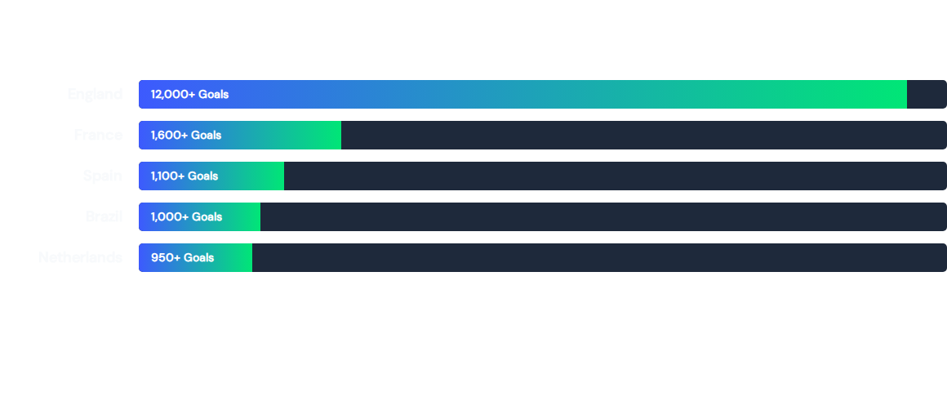
EPL GOALS BY NATIONALITY (ALL-TIME)
*Historical data provided for illustrative platform benchmarking.

Slide 6

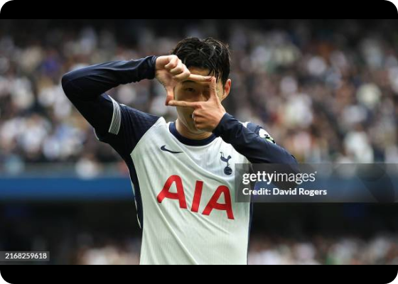
FOCUS: THE SOUTH KOREAN IMPACT
Son Heung-min (Spurs): Over 110 EPL goals and the first Asian Golden Boot winner.
Hwang Hee-chan (Wolves): A rising force with double-digit goals in 23/24 season.
Our platform enables deep-dive analytics into these localized performance metrics.

Slide 7
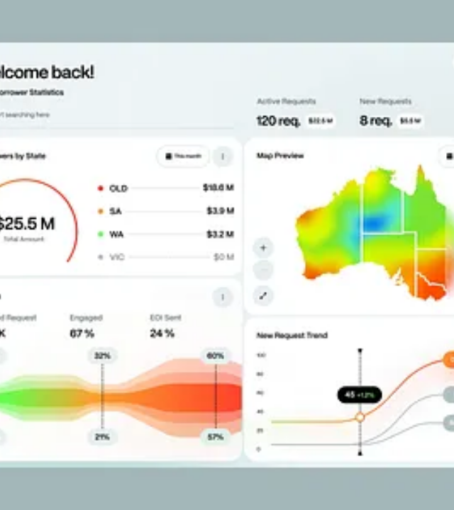
UI/UX STRATEGY
Interactive Visualization: Moving beyond tables with Radar Charts and Heatmaps to show player movement and skill-sets.
Mobile-First Design: Optimized for the "Second Screen" experience during live match weekends.
Data Density: Balancing complex football metrics with clean, accessible design for casual and hardcore fans.

Slide 8
Questions?
Thank you for your interest in the EPL Global Stats Project.
WWW.EPL-STATS-PROJECT.COM

Slide 9


IMAGE SOURCES
https://media.gettyimages.com/id/2168259618/fr/photo/london-england-son-heung-min-of-tottenham-hotspur-celebrates-after-scoring-their-second-goal.jpg?s=612x612&w=gi&k=20&c=GPqmHIJq_9i7GXogoQEGB3J-0tbSsNEbNeJ6wP7D6RM=
Source: www.gettyimages.fr
https://cdn.dribbble.com/userupload/45061726/file/still-cfc1804383dd4aa5a4b61b5341304c30.png?format=webp&resize=400x300&vertical=center
Source: dribbble.com

